Slide 1
Portfolio Review
Elise Nguyen UX Designer at Amazon Kindle
Notes:
Introduce yourself. Thank them for their time.

Slide 2
Shop Goodreads on Amazon
Helping customers buy their next read
Notes:
Transition to first project. This was a 4-month project that launched in April 2025.

Slide 3
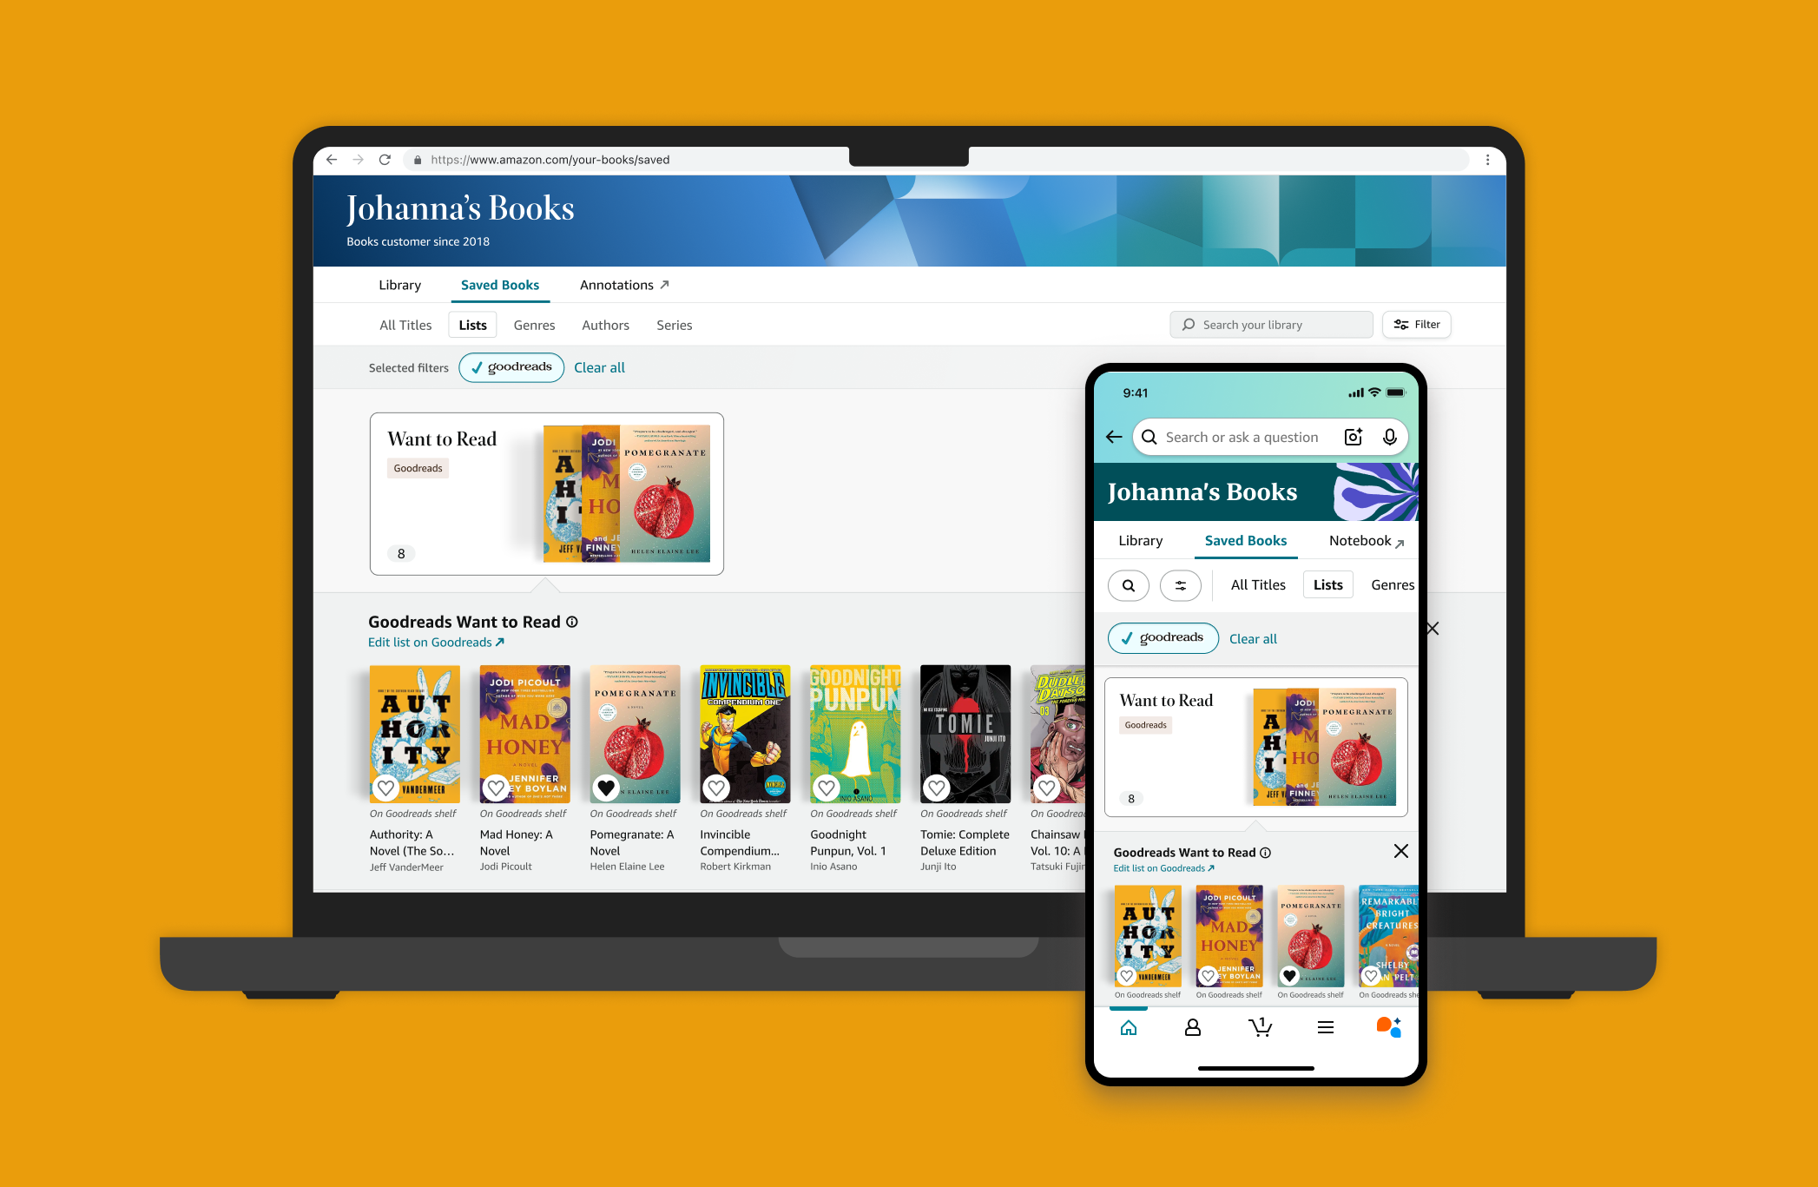
OVERVIEW
The Project
I designed a highly-requested feature that brings users' Goodreads Want to Read shelf into Amazon Your Books, letting them browse, filter, and shop their WTR titles all in one place.
→ Role: Primary UX Designer
→ Timeline: 4 months; Launched April 2025
→ Team: Kindle and Goodreads product and engineering teams
Notes:
This was the first-ever collaboration between Goodreads and Amazon Your Books teams. I was the sole designer on the project.

Slide 4
PROBLEM
A disconnected shopping experience
Readers use Goodreads to track books they want to read, but this information isn't easily accessible when they shop on Amazon.
→ Users struggle to find books already saved to their Want to Read shelf
→ 41.7M linked Goodreads and Amazon customers
→ Opportunity to integrate Goodreads into Amazon for seamless shopping
Notes:
The key insight here is that there's a huge user base already linking accounts, but the experience between the two platforms was fragmented.

Slide 5
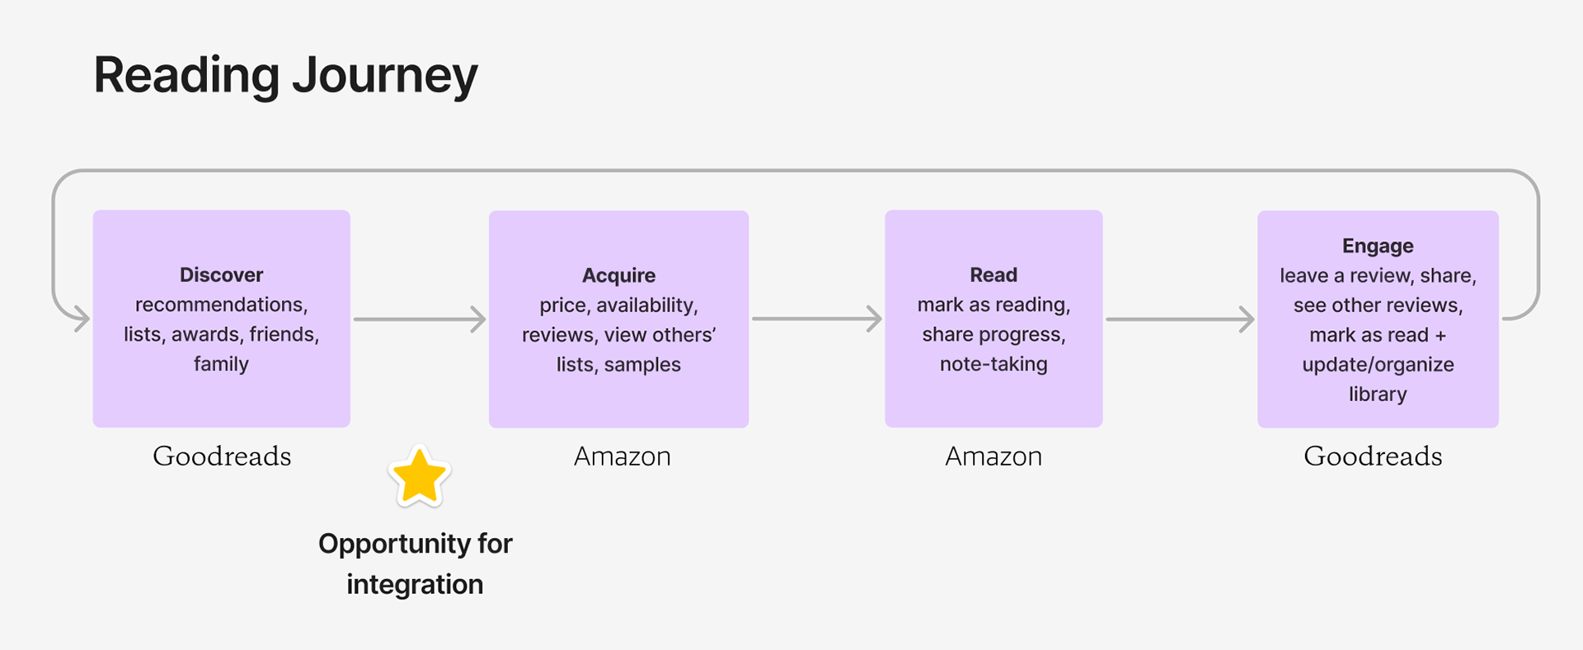
Notes:
This visual shows the disconnect - users had to manually search for books they'd already saved on Goodreads.

Slide 6
DESIGN CHALLENGE
How might we reduce friction between tracking books on Goodreads and purchasing them on Amazon?
Notes:
This was our north star question throughout the project.

Slide 7
THE CHALLENGE
Balancing integration with trust
Data showed the separation between Goodreads and Amazon was intentional:
→ Only one-third of linked users maintain lists on both platforms
→ Just one-fifth of books overlap between platforms
→ Users see Goodreads as impartial discovery, Amazon as transactional
Notes:
This was a critical insight from research. Users deliberately kept these platforms separate because they trusted Goodreads recommendations to be unbiased. We had to be careful not to break that trust.

Slide 8
MISSION
Design Principles
→ DO: Convenience - Single source of truth for total reading life
→ DO: Trust - Control visibility of books on both platforms
→ DO: Transparency - Context for where/why they see Goodreads content
→ DON'T: Friction - No context-switching between apps
→ DON'T: Bias - No sponsored content in Goodreads recommendations
Notes:
These principles guided every design decision. Whenever we had debates, we came back to these.

Slide 9
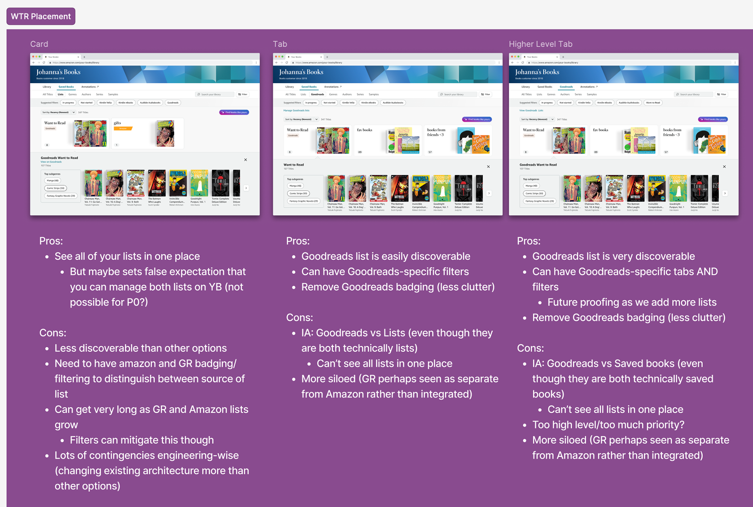
DESIGN DECISION #1
Information Architecture
Where does Goodreads fit into Your Books?
→ Option 1: Add Goodreads WTR as a filter and card
→ Option 2: Add Goodreads as a secondary tab
→ Option 3: Add Goodreads as a primary tab
Notes:
We explored three main approaches. Each had tradeoffs around discoverability, complexity, and future scalability.

Slide 10
Decision: Full integration
We aligned on fully integrating Goodreads Want to Read into the existing Your Books experience rather than introducing a separate Goodreads tab.
→ Builds on customers' current mental models
→ Avoids fragmenting the experience
→ Enables WTR books to benefit from Your Books' filters and recommendations
Notes:
This was a key alignment moment with both Amazon and Goodreads design teams. The decision prioritized user mental models over organizational boundaries.

Slide 11
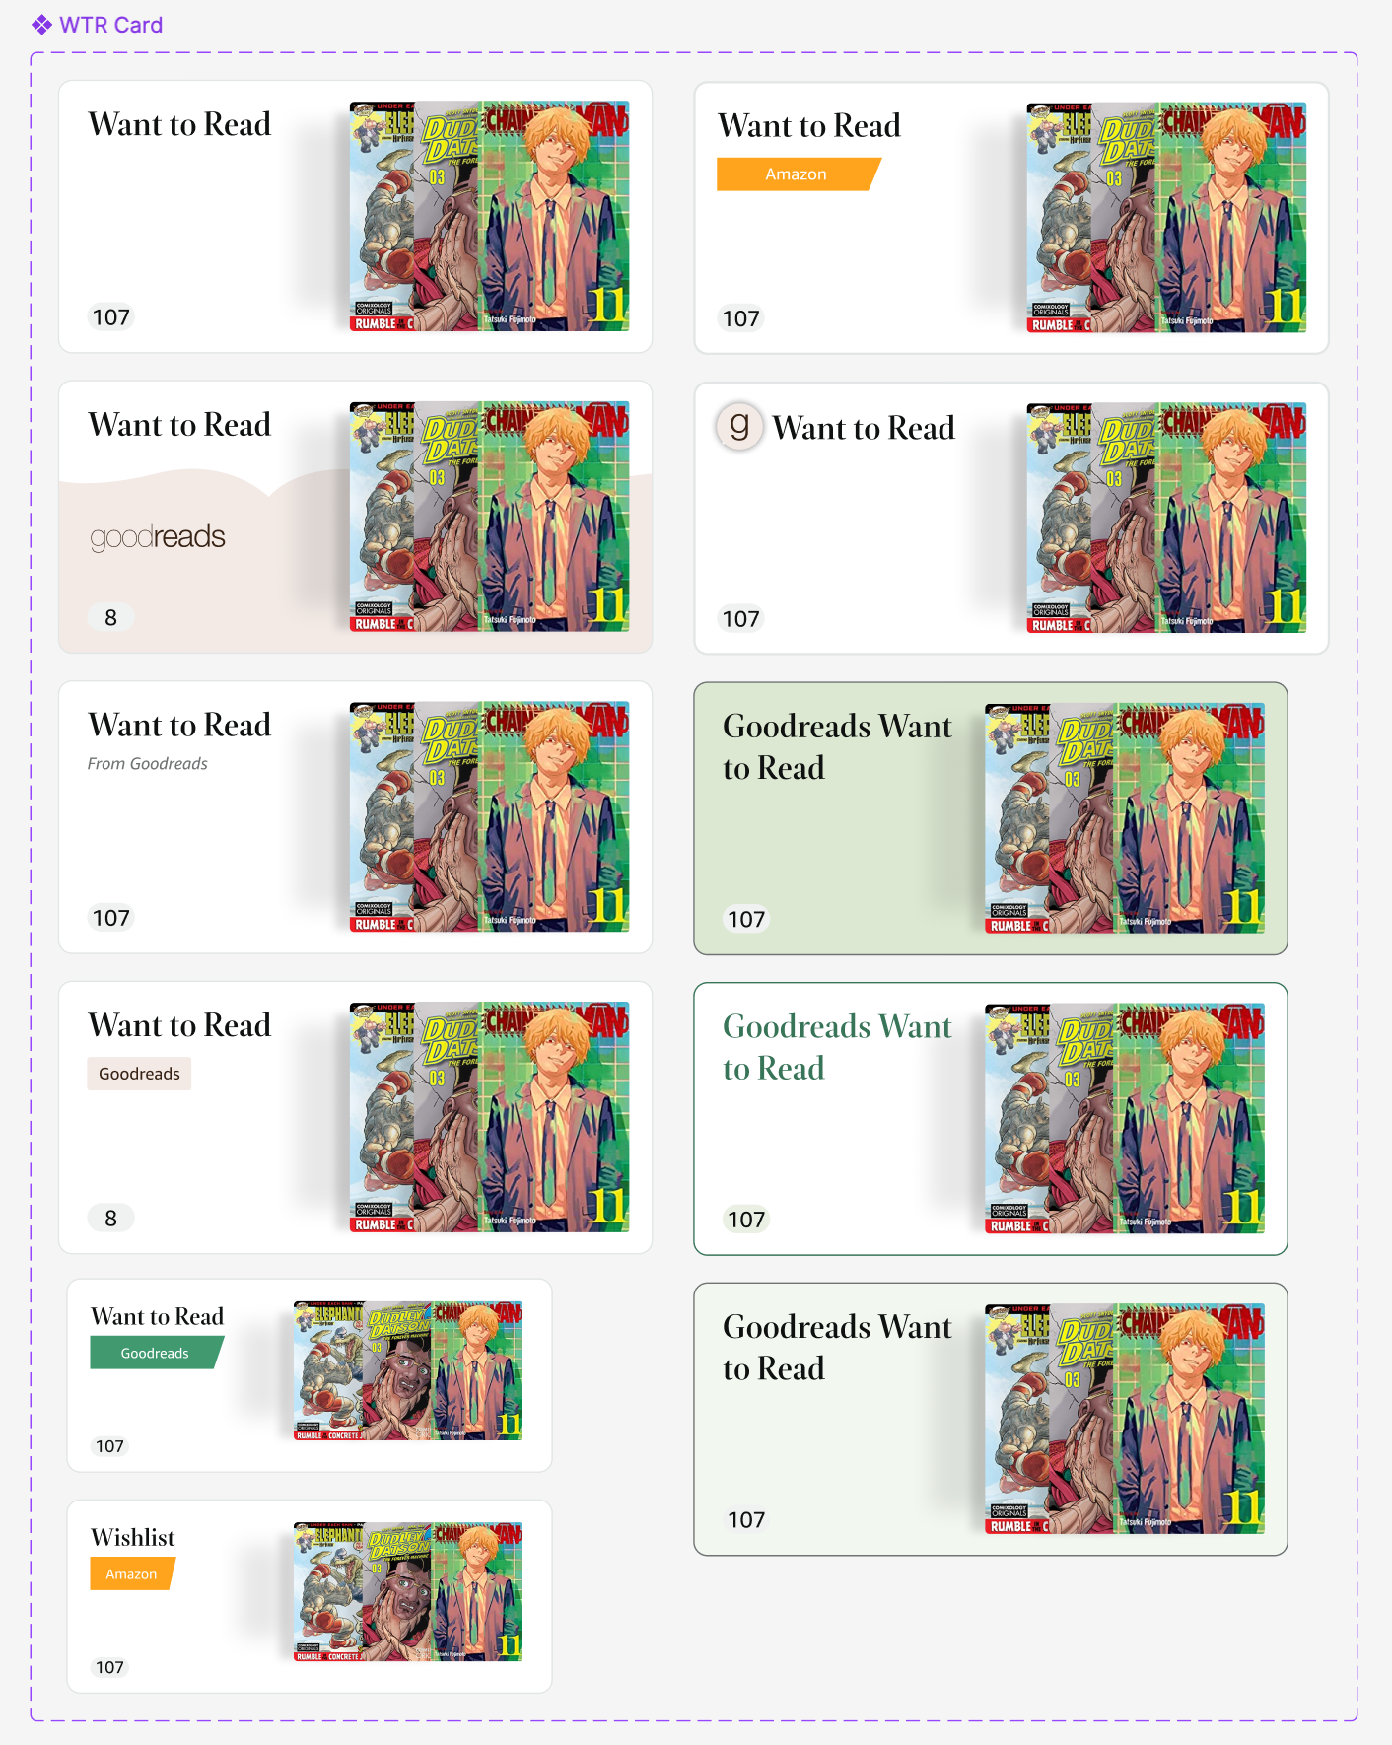
DESIGN DECISION #2
Badging
How do we differentiate Amazon wishlists from Goodreads shelves?
Notes:
We explored many options - logos, labels, colors. Each had tradeoffs around clarity vs. visual noise.

Slide 12
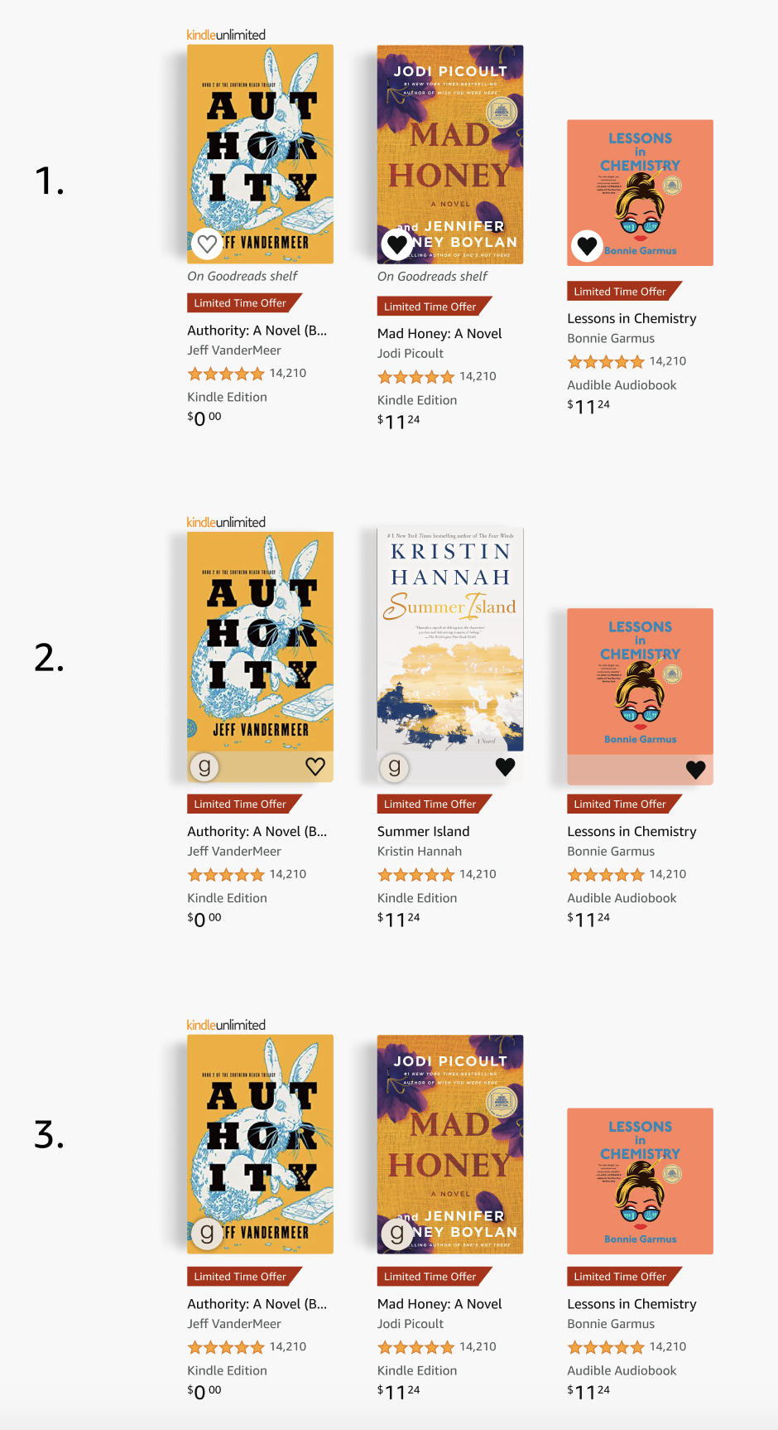
USER RESEARCH
Validating with users
Ran unmoderated usability test with 8 users on 3 badging options:
Notes:
User research was critical here because internal opinions were divided. We needed real user input to break the tie.

Slide 13
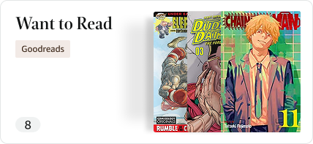
Research findings
Clear preference for 'On Goodreads shelf' label due to clarity and recognizability.
→ Logo-only approaches felt cleaner but introduced discoverability risks
→ Non-Goodreads users struggled with logo-only options
→ Explicit labeling prioritized comprehension over visual minimalism
Notes:
The key learning: when introducing something new, clarity beats elegance. We can evolve to more compact designs as users become familiar.

Slide 14
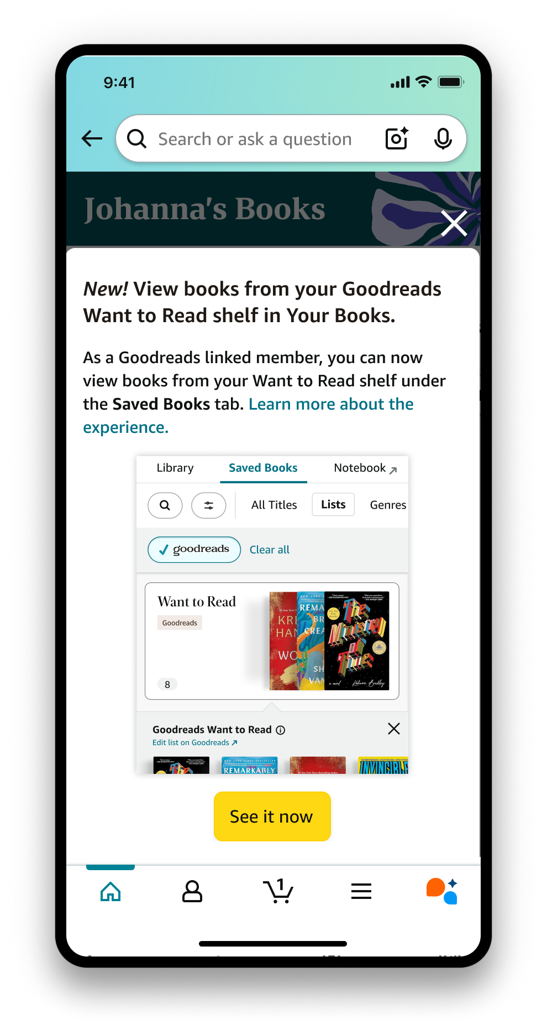
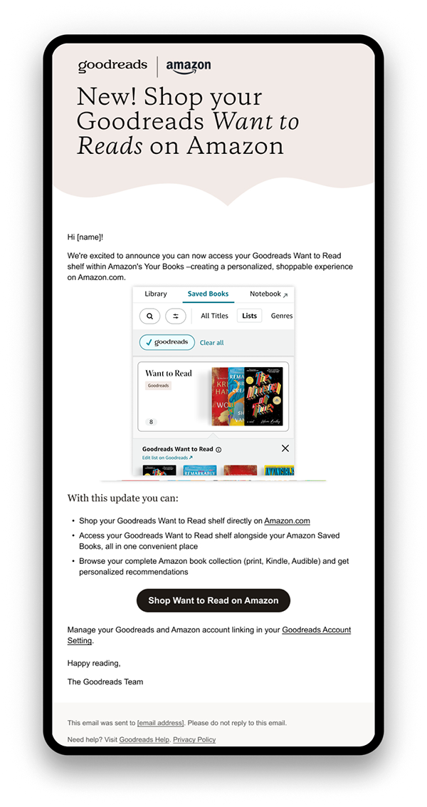
SOLUTION
Introducing a new integration
Notes:
A new modal within Your Books and email to Goodreads members introduces this integration, guiding them to the new experience.

Slide 15
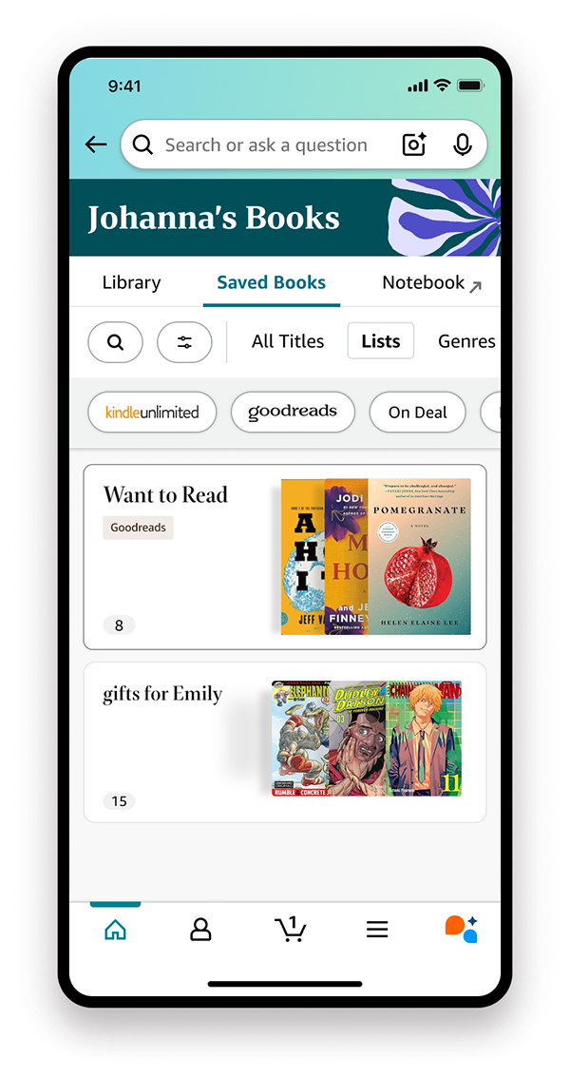
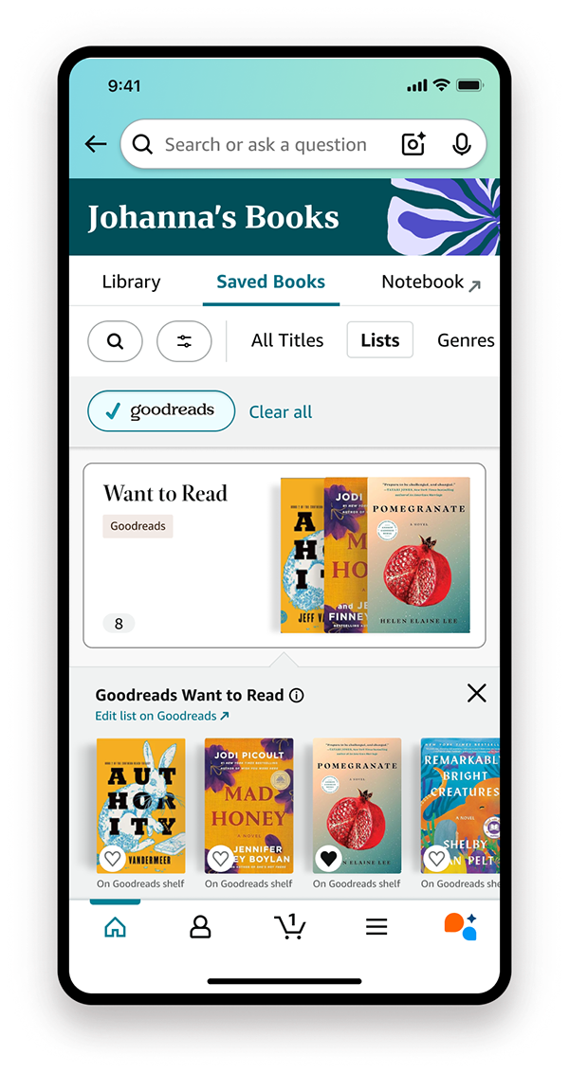
See all your lists in one place
Notes:
In the Lists tab, users can now view their Goodreads Want to Read shelf alongside Amazon wishlists. A new Goodreads filter and branded badge help users easily identify and navigate.

Slide 16
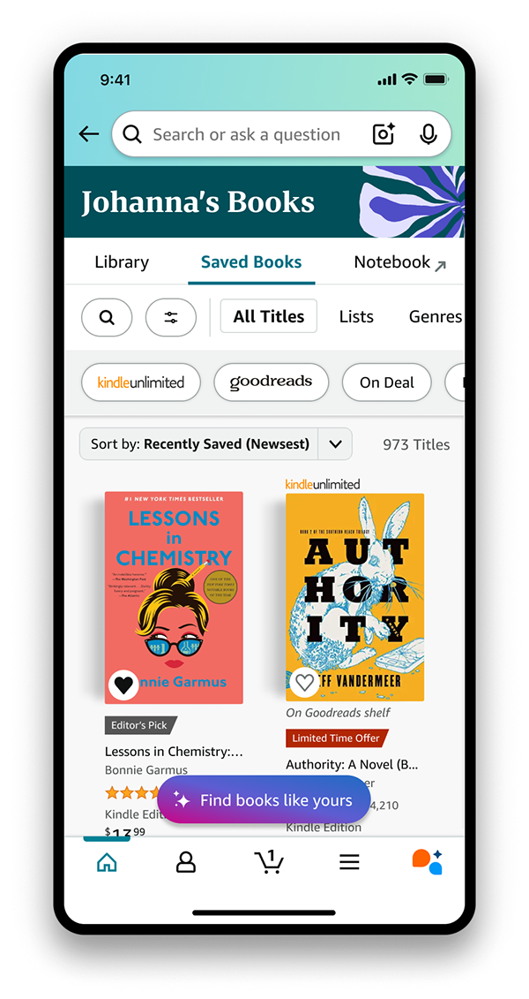
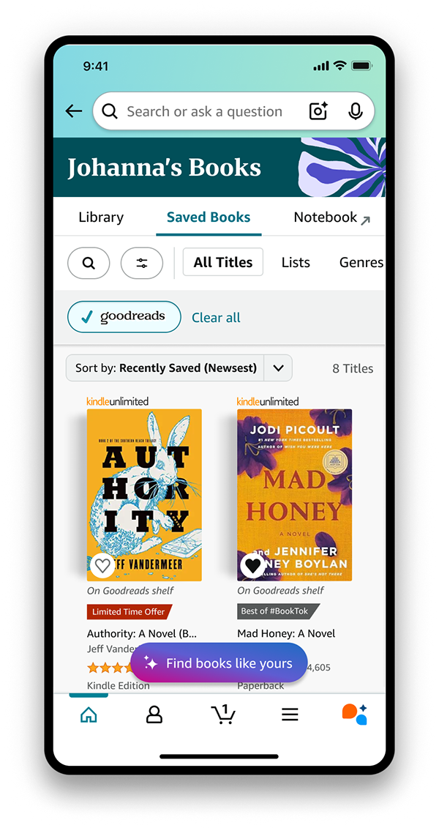
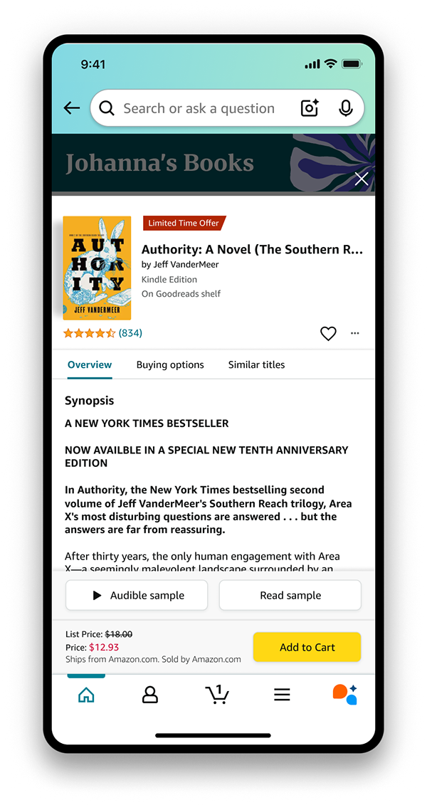
Shop all your books at once
Notes:
In the All Titles tab, users can browse their complete book collection from both Amazon and Goodreads in one unified view.

Slide 17
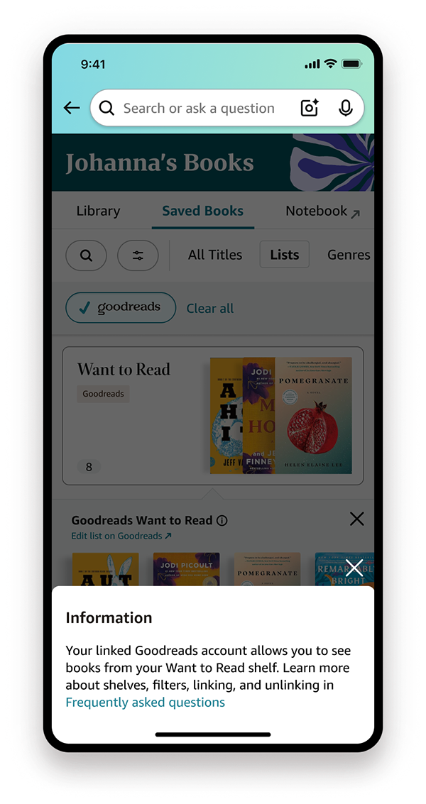
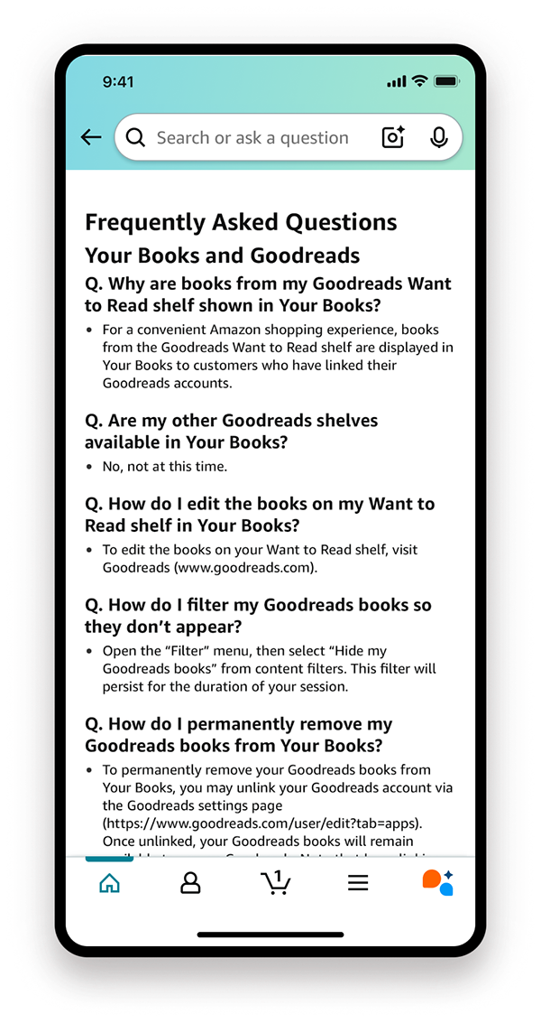
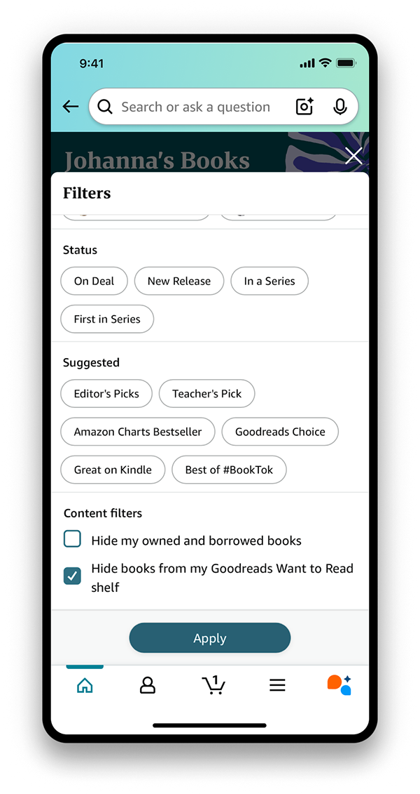
Your books. Your choice.
Notes:
Users have full control to learn more about the feature, hide Goodreads books from their view, or unlink accounts entirely. This was critical for maintaining trust.

Slide 18
OUTCOME
Impact
Launched April 22, 2025 for 9.2M linked monthly active users (41.7M total).
→ 86% higher engagement for WTR shelved books vs. Wishlist books
→ Strong positive customer feedback
→ Featured in Fast Company and viral TikTok coverage
Notes:
The engagement numbers exceeded our expectations. The 86% higher engagement showed users were actively using the integration.

Slide 19
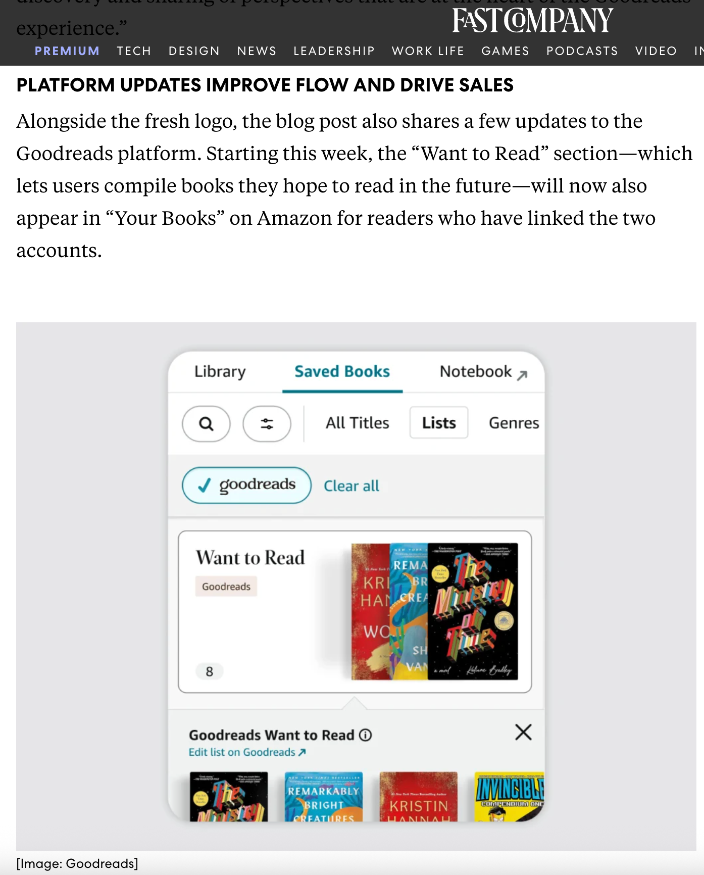
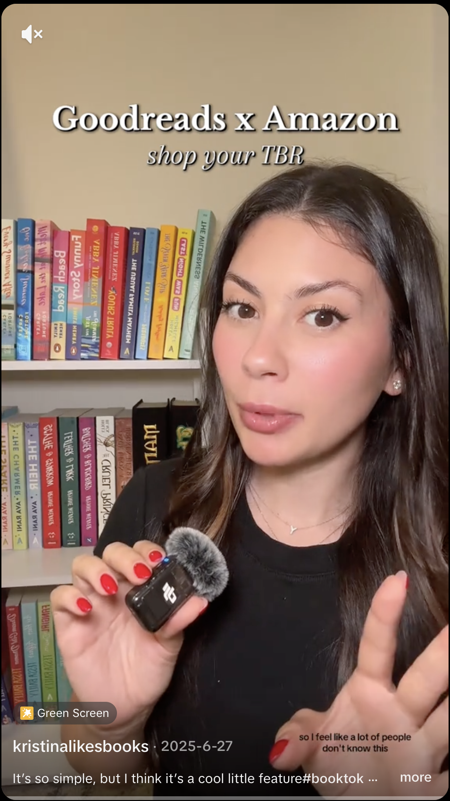
What users are saying
→ "This has been something I've wanted for years."
→ "I don't have to go back and forth to remember what I put on my TBR list!"
→ "No longer having to track my want to buy book list in both Amazon and Goodreads"
Notes:
These customer quotes validated our design decisions. The pain point we identified was real and the solution resonated.

Slide 20
LEARNINGS
What I learned
→ Design across two distinct platforms and brands while navigating complex cross-team dynamics
→ Drive alignment on decisions and synthesize feedback from many stakeholders
→ Design within existing information architecture that differed from both Goodreads and Kindle
→ Thoughtfully merge two brands by respecting what makes each valuable to users
Notes:
This project taught me a lot about cross-team collaboration and designing for trust. The biggest challenge wasn't the UI - it was aligning two different organizations with different goals.

Slide 21
Color Writing on Kindle
Designing color writing and annotation for Kindle Scribe's debut e-ink color display
Notes:
Transition to second project. This was a 7-month project for a hardware launch - very different pace and constraints than the first project.

Slide 22
OVERVIEW
The Project
I owned the design for the color writing and annotation experience for Kindle Scribe's debut e-ink color display.
→ Role: UX Designer
→ Timeline: 7 months; Launched December 2025
→ Team: Kindle UX, PM, and engineering teams
Notes:
This was Kindle's first color writing device ever. I owned the entire color writing experience - annotations, writing tools, bookmarks, and templates.

Slide 23
OPPORTUNITY
Kindle's first color writing device
Kindle Color Scribe introduces color as a new medium for annotation, writing, and organization.
→ Define what color means on a device built around focus and simplicity
→ Enable richer ways to highlight, write, and structure ideas
→ Preserve the calm, immersive reading experience Kindle is known for
Notes:
The opportunity was exciting but also challenging - how do you add color without making the device feel cluttered or distracting?

Slide 24
DESIGN CHALLENGE
How might we introduce powerful color writing tools while still preserving the flow of deep reading and writing?
Notes:
This tension between power and simplicity was the core challenge throughout the project.

Slide 25
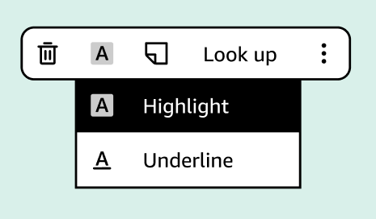
DESIGN CHALLENGE #1
Adding color to annotations
The in-book contextual action bar (CAB) had to feel almost invisible—powerful when needed, effortless when not.
→ Challenge: Fitting more functionality into constrained, frequently used space
→ Goal: Minimize cognitive load while preserving fast, one-tap access
Notes:
The CAB is one of the most-used UI elements on Kindle. Any changes here had to be extremely well-considered.

Slide 26
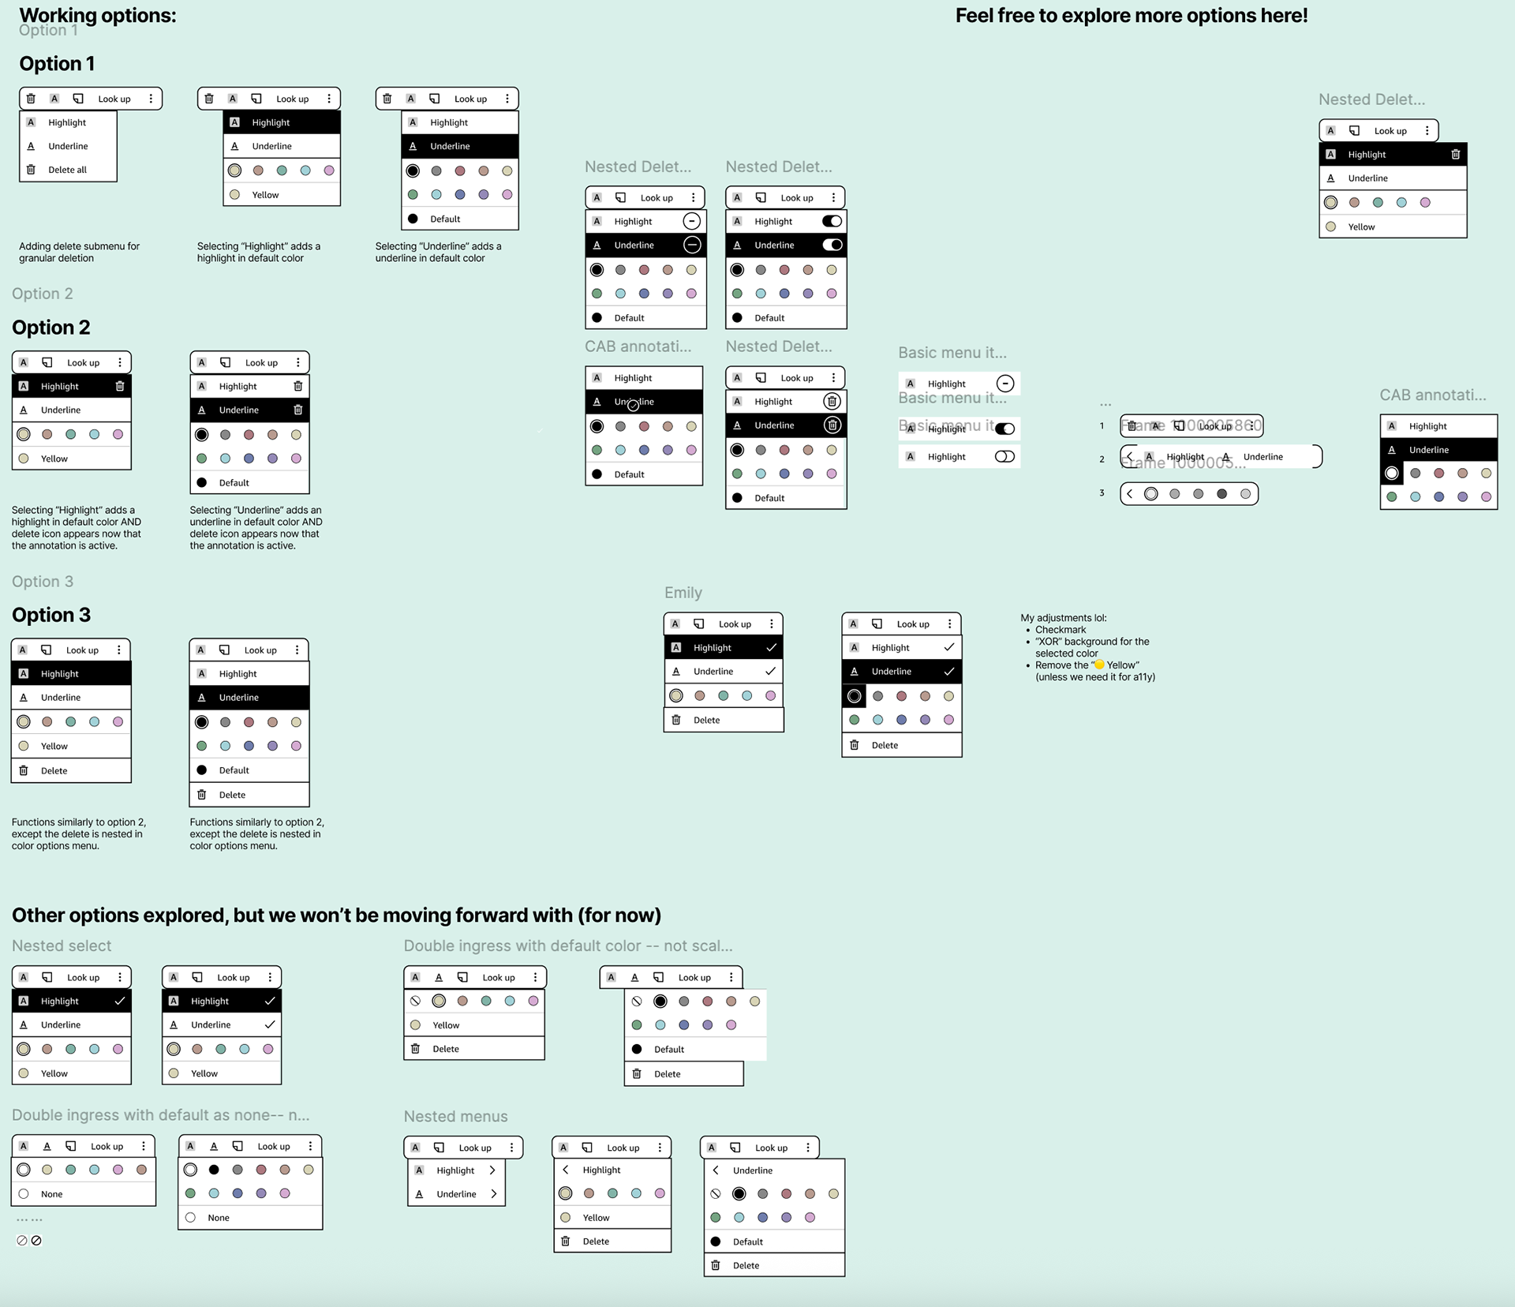
Iterating on the CAB
Notes:
Early explorations tested multiple interaction models - toggles, nested menus, explicit delete actions. We used design crits and usability principles to pressure-test each option.

Slide 27
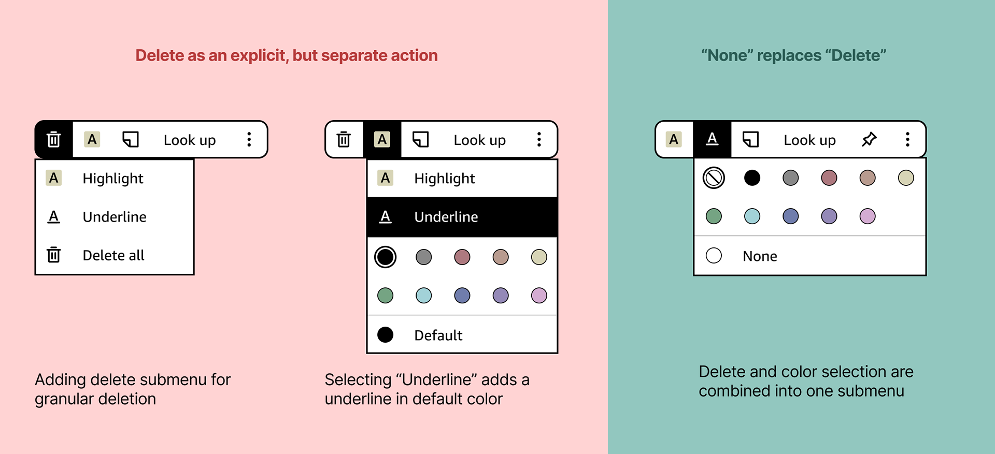
Simplifying the menu
→ Removed explicit delete action—folded into 'None' option in color submenu
→ Kept highlight and underline as first-class actions (not nested)
→ Prioritized clarity for today's core use cases
Notes:
One of the most important decisions was removing the explicit delete action. This reframed deletion as part of editing, not a separate mode.

Slide 28
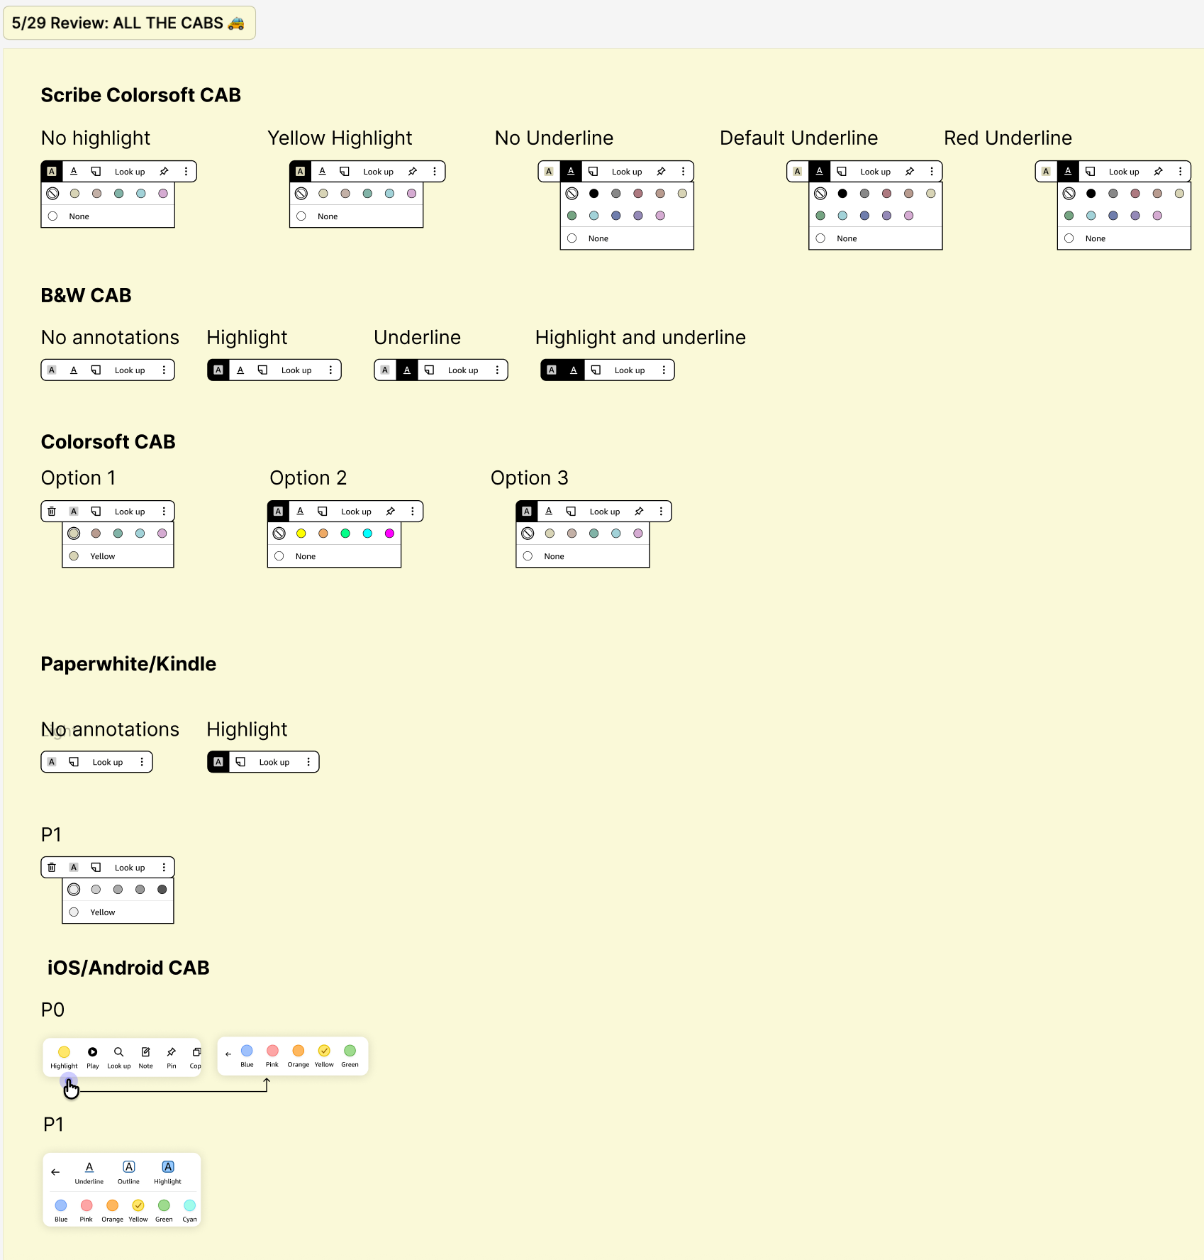
Designing cross-surface
The CAB needed to flex across color and black-and-white devices with different technical constraints.
→ Surface-appropriate designs preserving same mental model
→ Adapting interaction patterns per device capabilities
Notes:
Rather than enforcing strict uniformity, I advocated for surface-appropriate designs. This added engineering complexity but resulted in better UX for each user group.

Slide 29
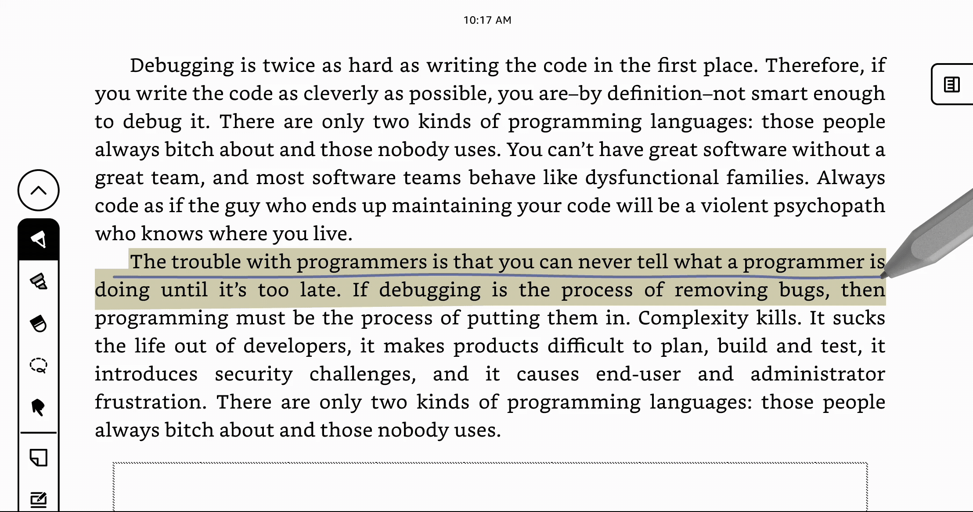
RESULT
Final annotation experience
Fast, flexible annotation without interrupting reading flow.
→ CSAT: 6.14/7 for color highlights and underlines in beta testing
→ Annotations not flagged as pain point during beta or launch
Notes:
The high CSAT score validated our approach. Most importantly, users could annotate without breaking immersion.

Slide 30
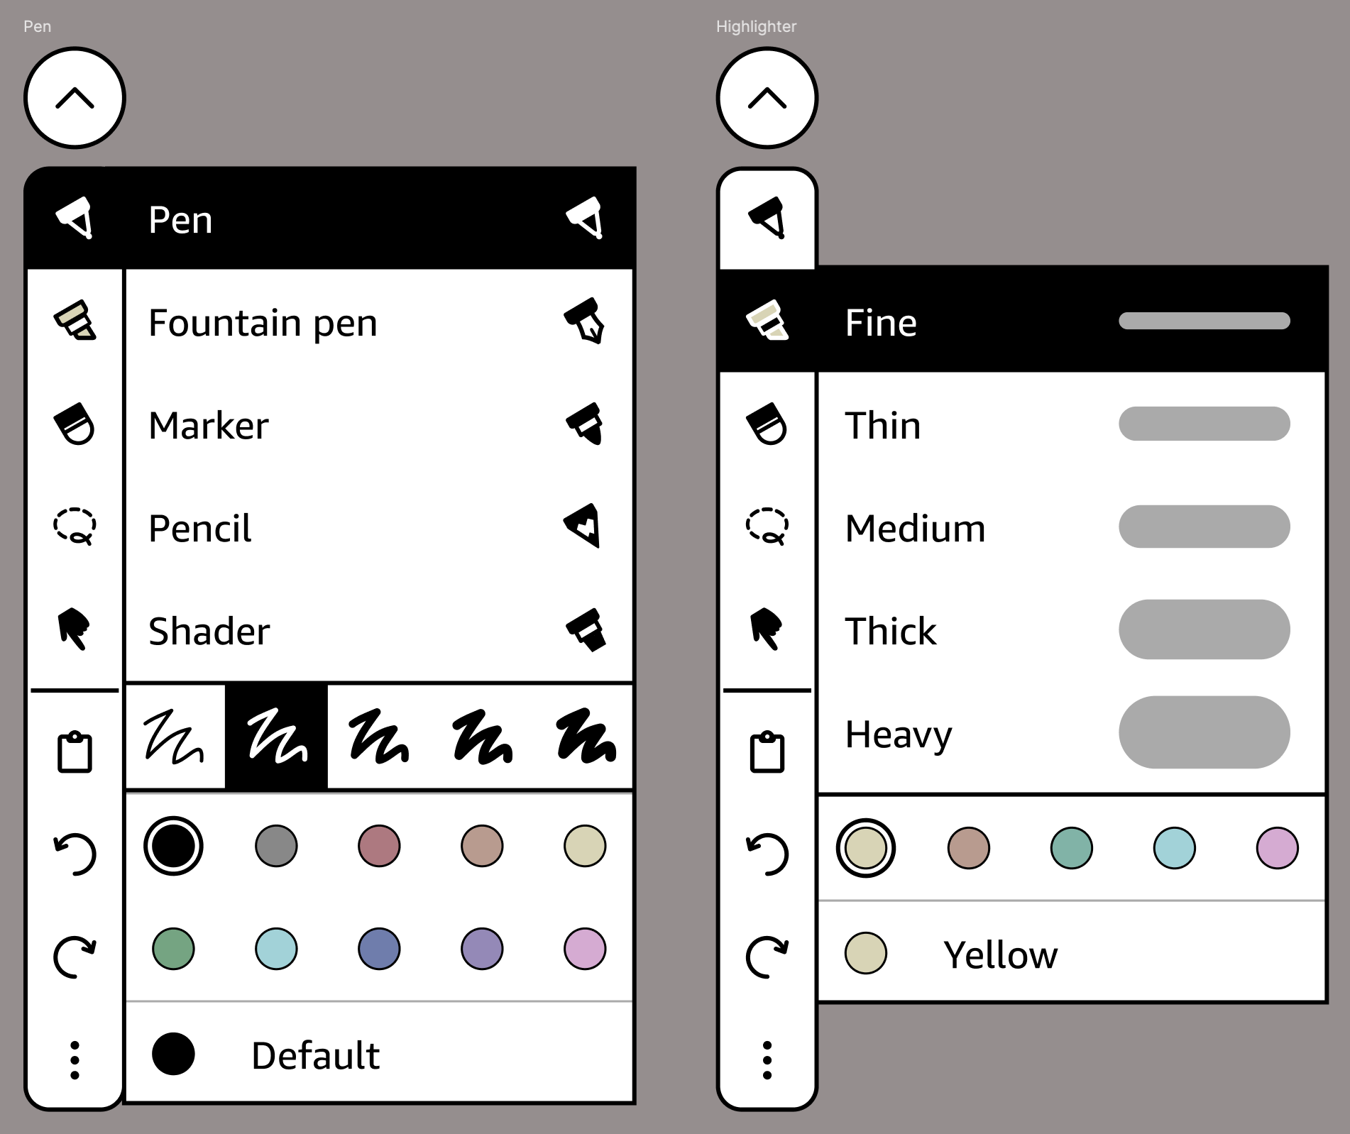
DESIGN CHALLENGE #2
Color switching friction
User research and beta feedback consistently surfaced color switching as a pain point.
→ Color options nested in submenu requiring multiple taps
→ Most users only use 2-3 colors in a session
Notes:
This was identified through beta feedback. The existing design worked functionally but interrupted flow for users who switch colors frequently.

Slide 31
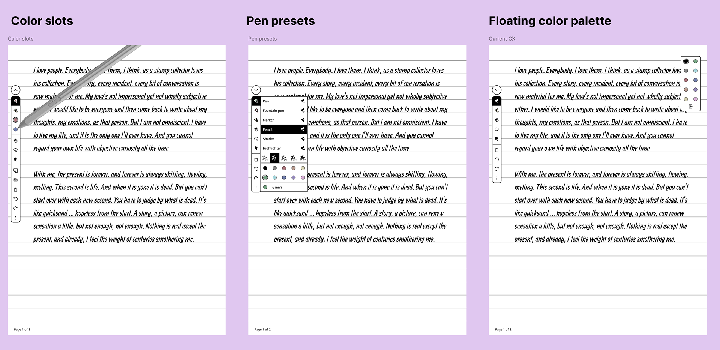
Exploring solutions
→ Color slots: Fastest switching, minimal cognitive load once learned
→ Pen presets: Bundled tool type + color, but added setup complexity
→ Floating palettes: Most discoverable, but covered writing space
Notes:
Each direction had clear tradeoffs. We evaluated based on speed, simplicity, and technical feasibility given our timeline.

Slide 32
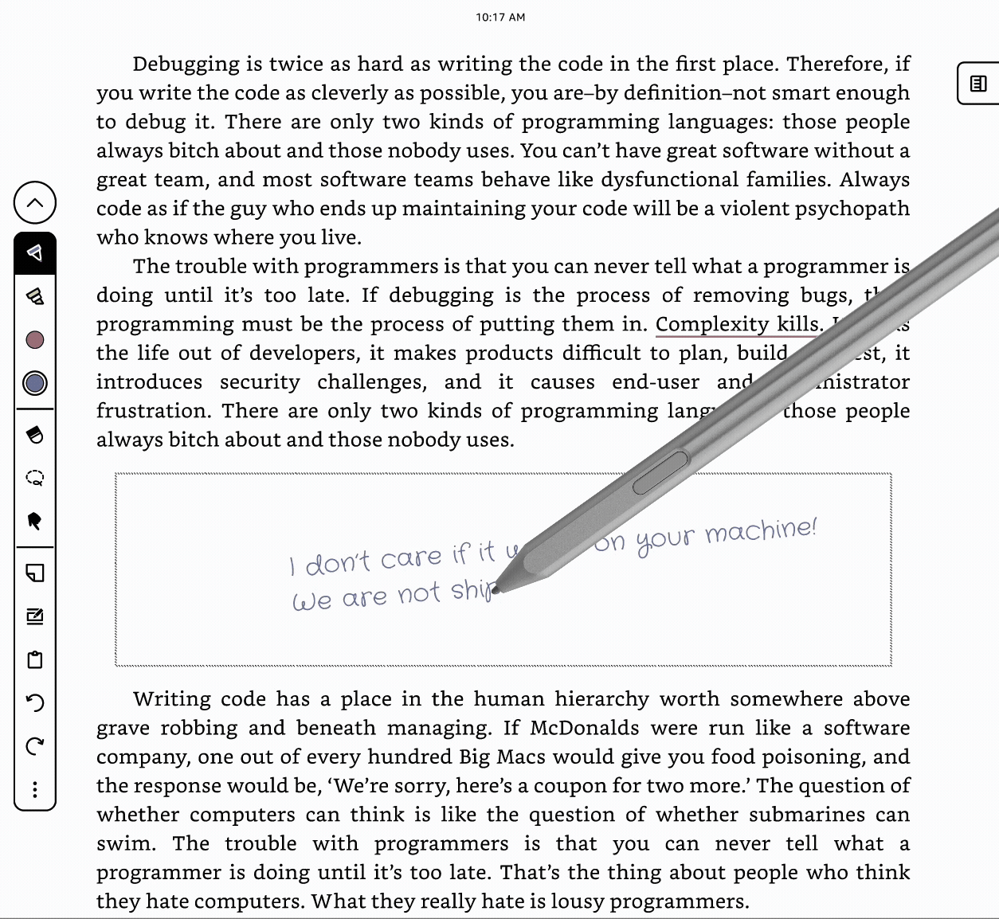
RESULT
Color slots solution
Aligned on color slots as the best balance of speed, simplicity, and feasibility.
→ Customer satisfaction: 6.10/7
→ Over 80% rated pen color controls as easy or very easy to use
→ Writing in color felt as fluid as black ink
Notes:
Internal beta validated this approach. The key success metric was that color didn't slow users down.

Slide 33
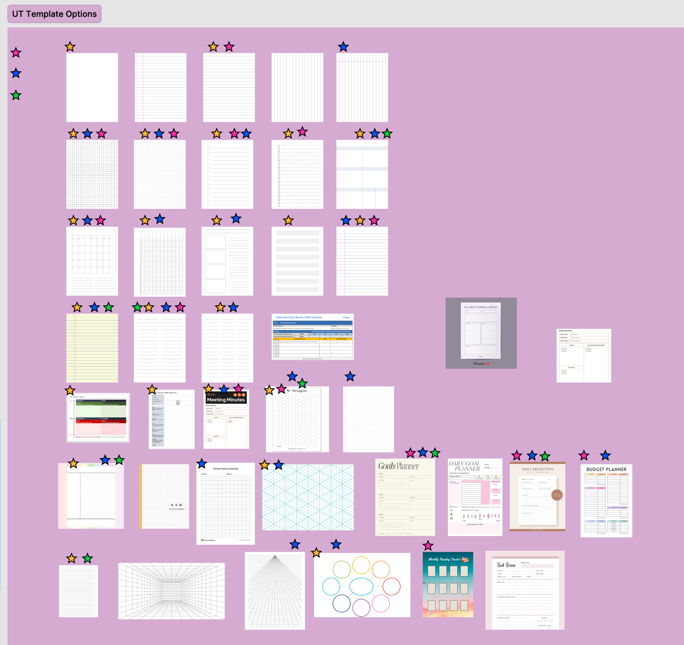
DESIGN CHALLENGE #3
Templates
Rather than designing from taste, I partnered with UX Research to anchor decisions in user input.
Notes:
Templates are inherently personal, so we needed research to guide decisions rather than relying on internal opinions.

Slide 34
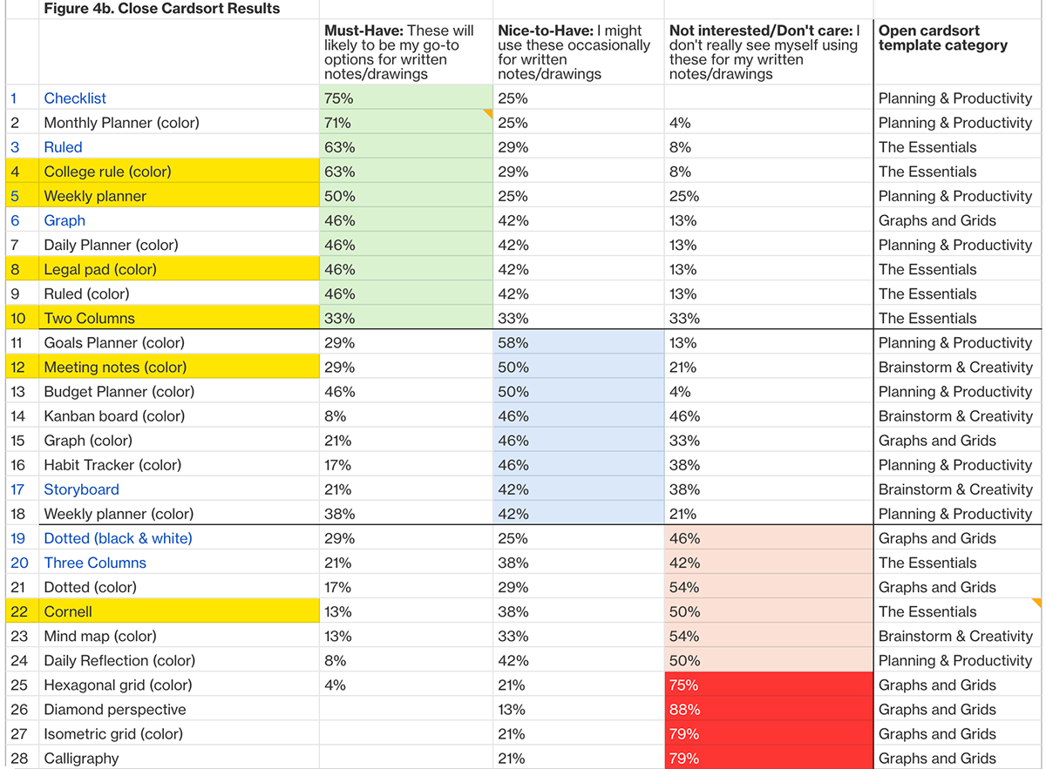
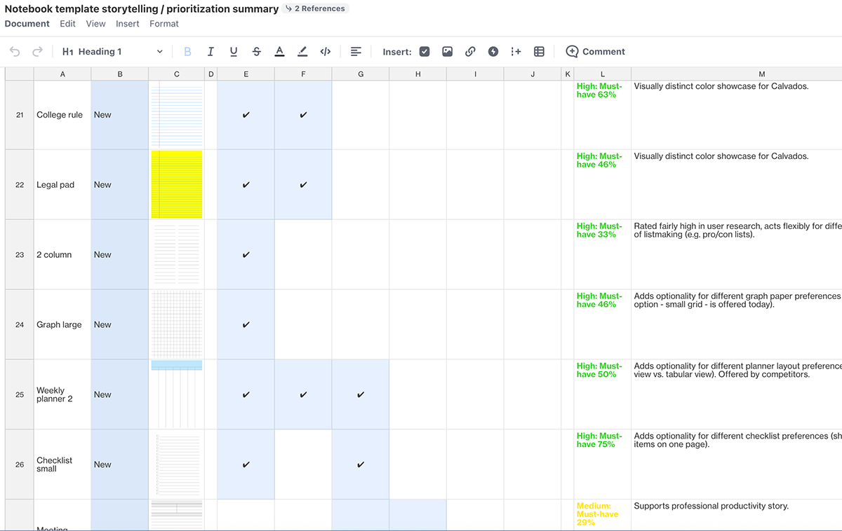
What users actually wanted
→ Users favored simple, versatile templates over decorative designs
→ Contrary to internal pressure, users preferred black-and-white templates
→ Customizability emerged as strongest unmet need
Notes:
This was surprising - there was internal pressure to add more colorful templates, but users consistently preferred simplicity.

Slide 35
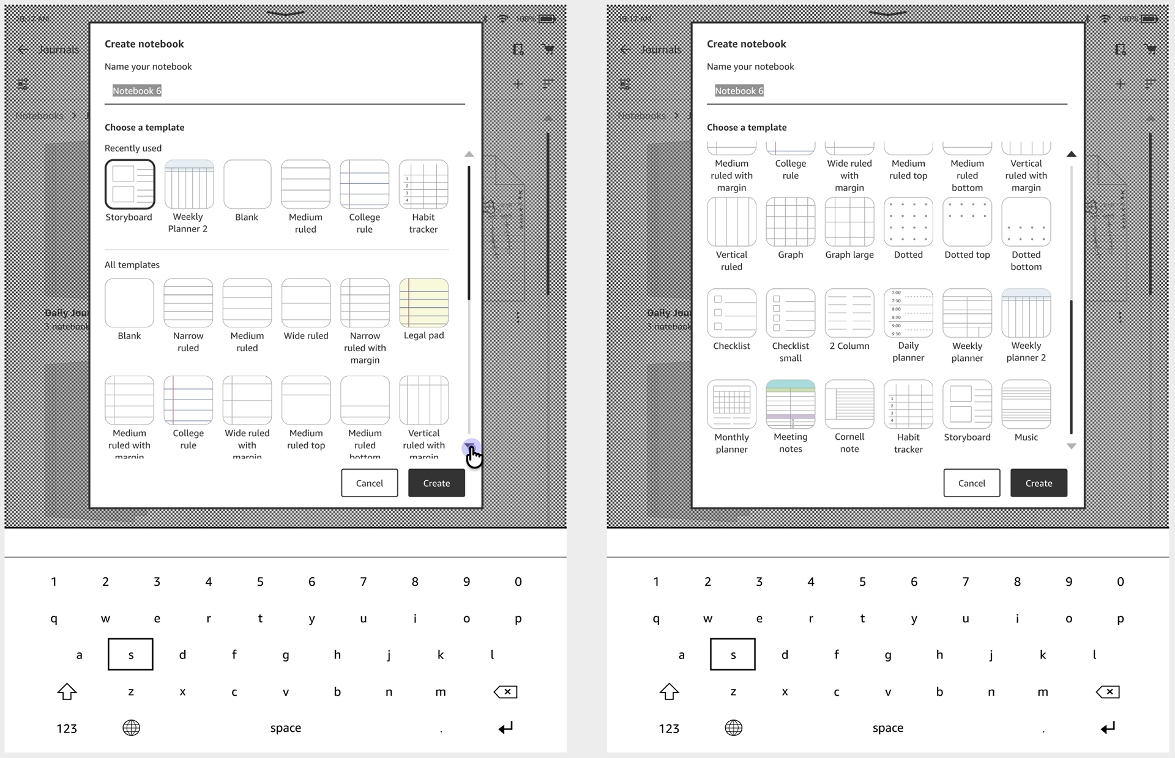
Making 30 templates manageable
As the library grew, discoverability became the next challenge.
→ Solution: 'Recently used' row at top of picker
→ 93% rating for creating notebooks with templates
→ Users reported it as 'intuitive'
Notes:
The recently used row optimized for real usage patterns without adding UI complexity.

Slide 36
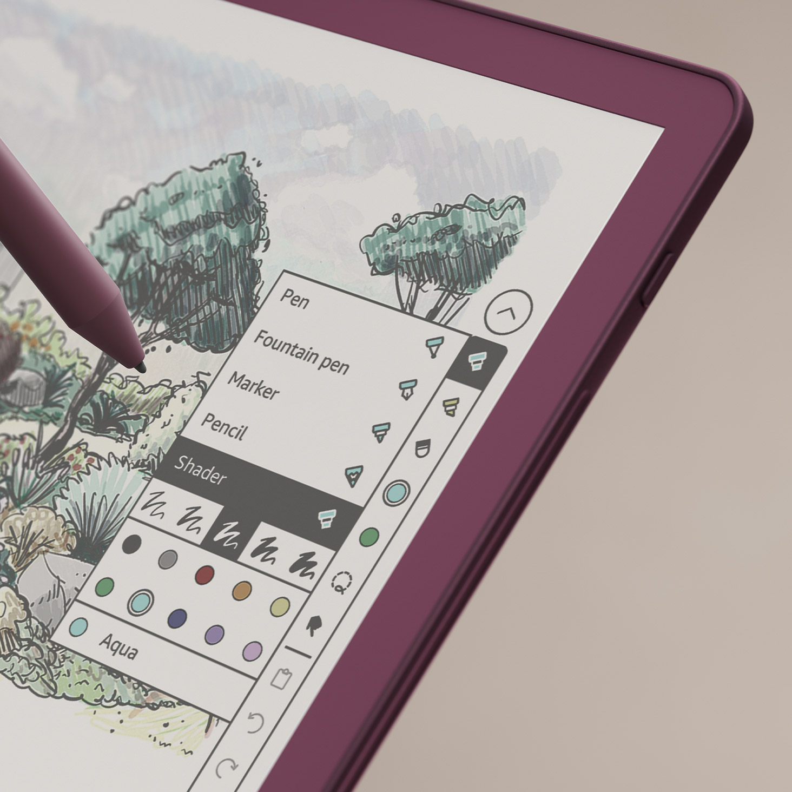
SOLUTION
Writing that feels like pen and paper
Notes:
Configurable color slots enable one-tap switching between most-used colors, while lasso select helps make quick bulk color adjustments.

Slide 37
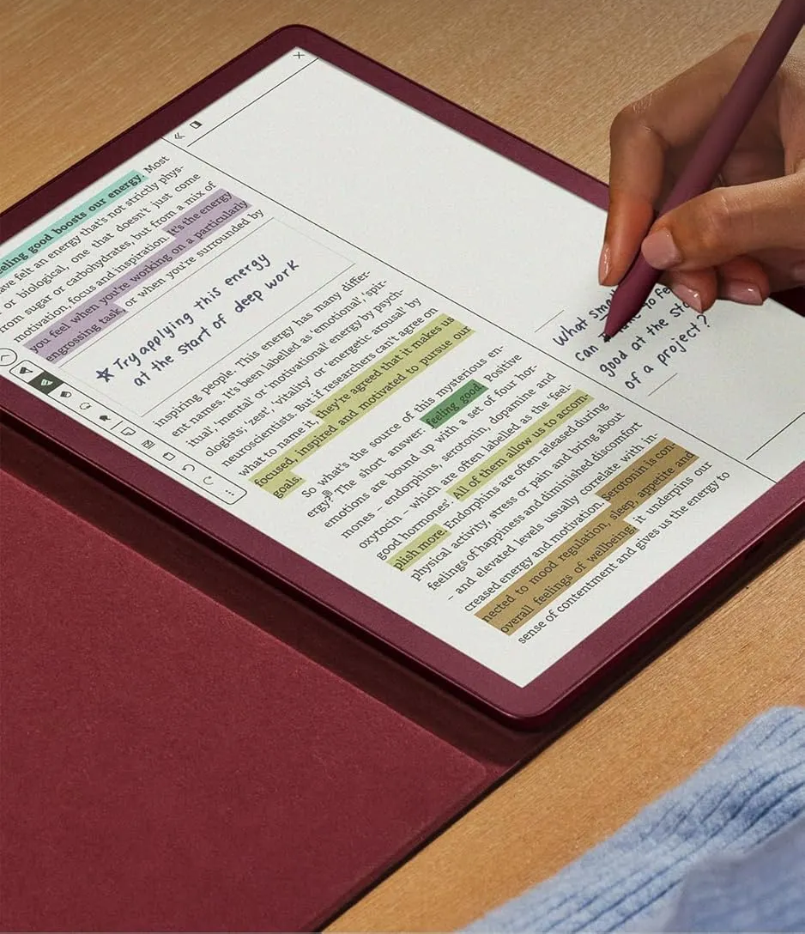
Powerful annotation experience
Notes:
Highlight, underline, and annotate in color. Color and date filters let you quickly find what matters most.

Slide 38
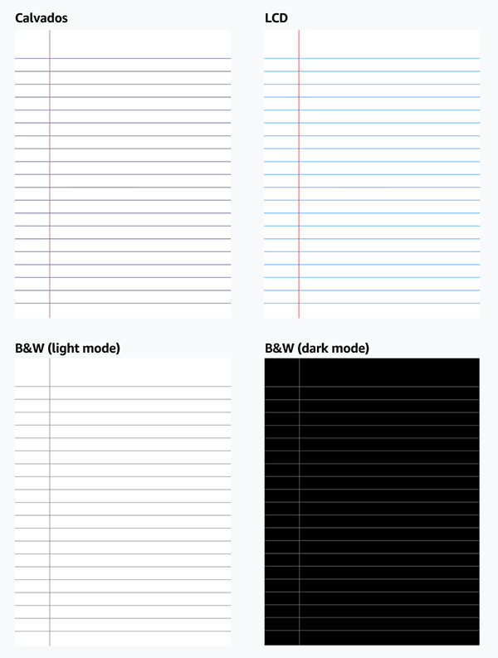
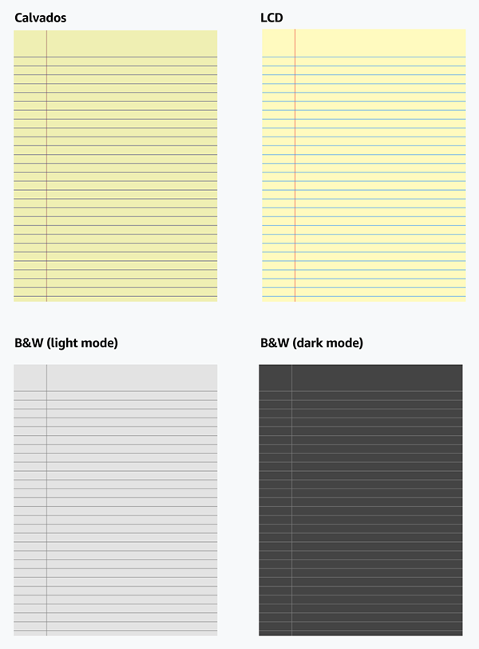
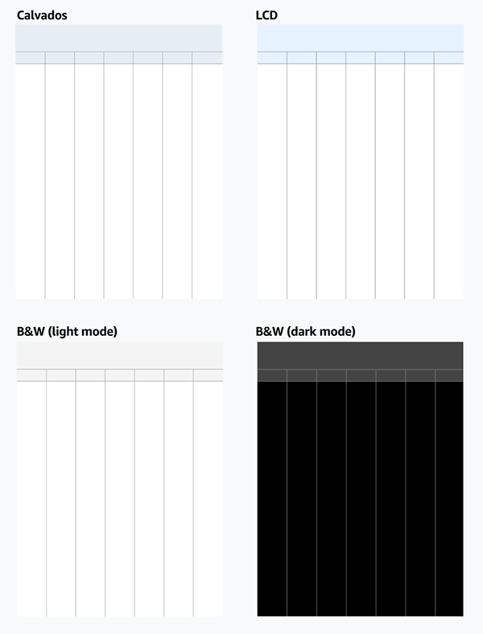
Curated templates
Notes:
Added 12 new, top-ranked templates based on user research, plus familiar colored options like college ruled and legal pad.

Slide 39
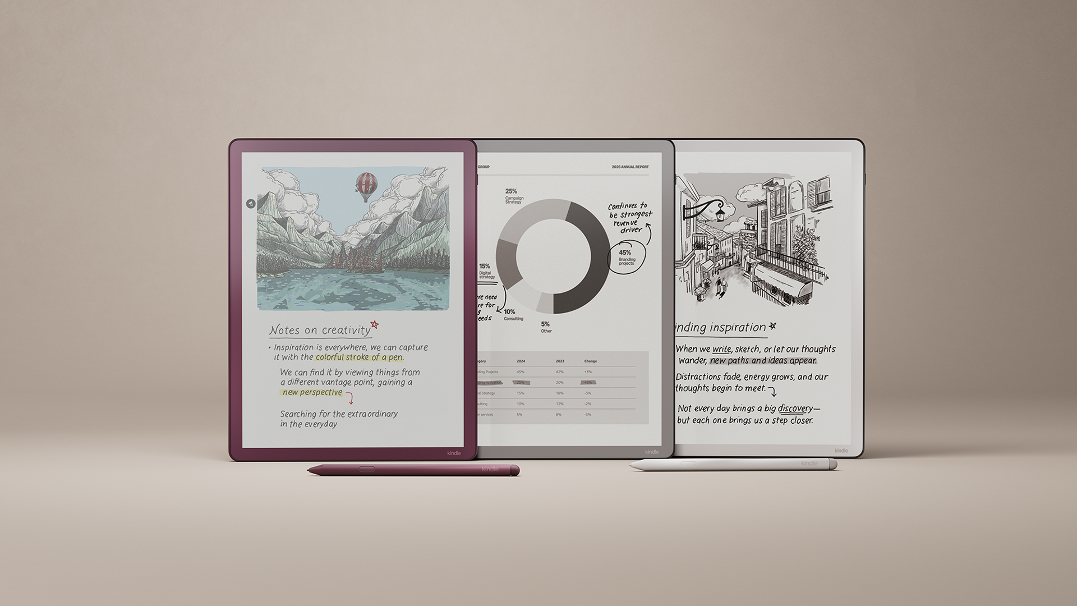
OUTCOME
Launch
Kindle Scribe Colorsoft launched December 10, 2025.
→ "Smooth writing feel. Easy to use." — Wired
→ "The software stays out of the way" — Inc.
→ "A feature I didn't know I wanted or needed." — Good Housekeeping
Notes:
The press reception was very positive. The key theme in reviews was that the software felt natural and unobtrusive.

Slide 40
LEARNINGS
What I learned
→ Define new interaction patterns while earning user trust on traditionally grayscale product
→ Systems thinking across surfaces—when to unify vs. allow divergence
→ Reduce cognitive load and preserve flow in high-speed interactions
→ Treat technical constraints as design inputs—adapting solutions to remain intuitive
Notes:
This project pushed me to think about systems design and how to introduce new capabilities without overwhelming users. The biggest lesson was treating constraints as design inputs rather than blockers.

Slide 41
Thank you!
Elise Nguyen elisenguyen.com
Notes:
Thank them for their time. Open for questions.

